Slide 1


Foodie Express: Online Food Delivery System
P.Jagadeesh Kumar
jagadeeshpuppala01@gmail.com

Slide 2

CONTENTS
1. Introduction
2. Objectives and Scope
3. Stakeholders
4. System Features
5. System Design & Architecture
6. User Flow & Use Cases
7. Advanced Features and Innovations
8. Testing, Security & Deployment
9. Conclusion
Appendix
References:

Slide 3

01
Introduction

Slide 4
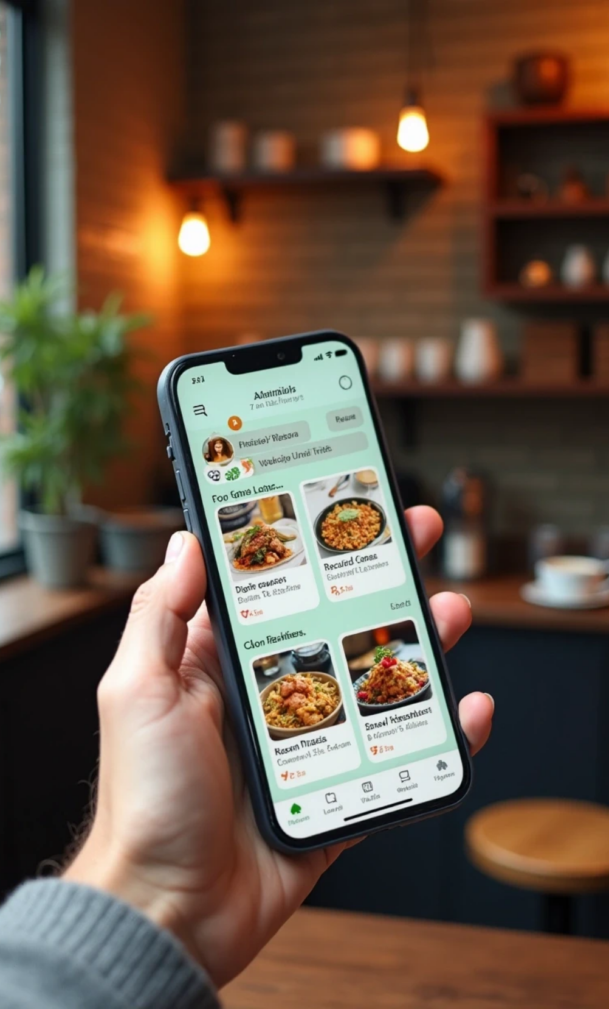
Introduction
Foodie Express is an advanced online food delivery platform, inspired by leading apps like Swiggy. It enables users to browse restaurants, explore menus, place customized orders, and track deliveries in real-time, all from a single, feature-rich interface. The project is designed for scalability, usability, and modern convenience.

Slide 5

02
Objectives and Scope

Slide 6
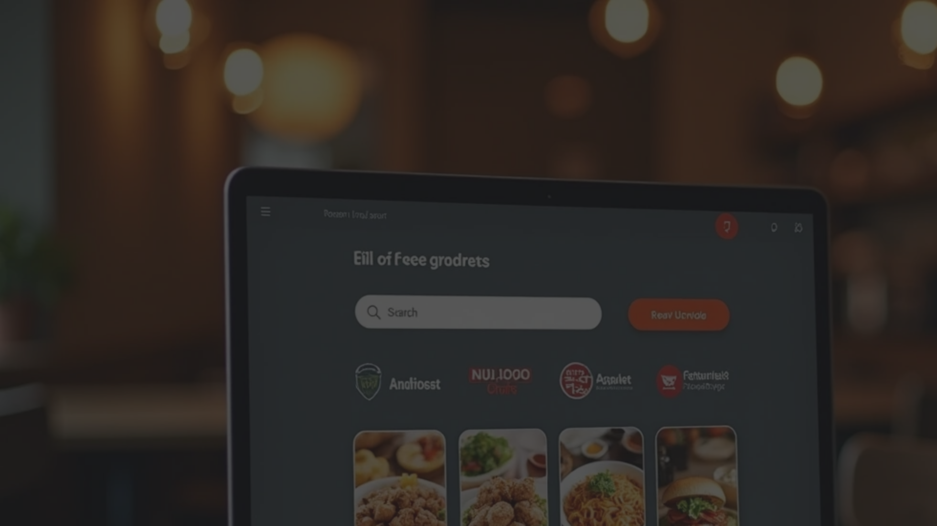

Objectives and Scope
Objective
Simplify food ordering and improve restaurant discoverability using a web-based digital platform.
Scope
• User registration, login, and management
• Restaurant and menu browsing with filter/search
• Cart and order management
• Multiple secure payment options
• Real-time order status and notifications
• Admin panel for analytics and management
• Advanced features: wishlist, loyalty rewards, dark/light theme, multilingual support, live chat, and more.

Slide 7

03
Stakeholders

Slide 8


Stakeholders
Customers
Restaurant Partners
Order and track food, manage their profile, provide ratings and feedback.
Manage menus, receive/manage incoming orders, monitor analytics.
Delivery Partners
Admin
Receive delivery notifications, update order status, communicate with customers.
Oversee users, restaurants, orders, analytics, and system content.

Slide 9

04
System Features

Slide 10
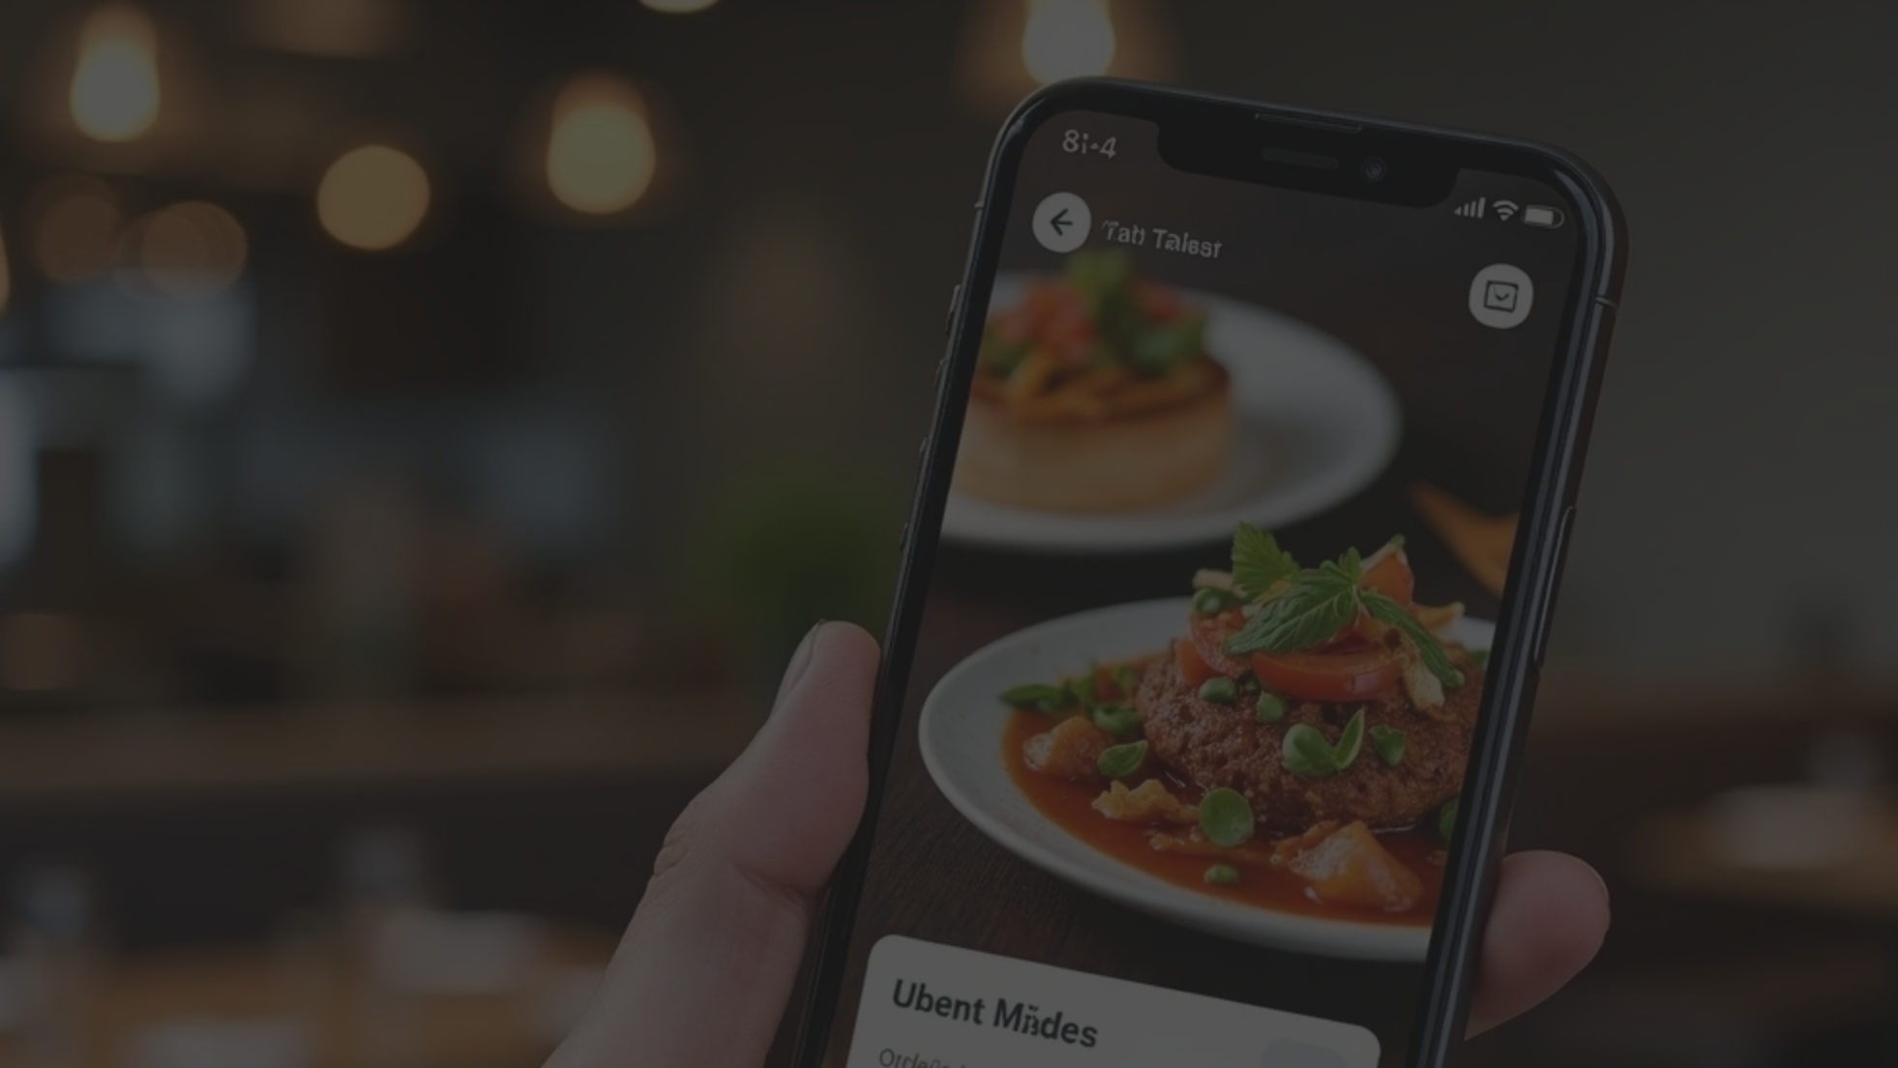

System Features
User Interface:
Ordering and Delivery:
Admin & Restaurant Dashboards:
• Responsive design (desktop, tablet, mobile).
• Browse restaurants/menus by filters (budget, delivery time, rating, distance).
• Analytics dashboard (orders, revenue, trends).
• Dark/light mode toggle.
• Restaurant and food item management.
• Customizable menu items.
• English, Hindi, French, and Spanish language support.
• Cart management (add, edit, remove items).
• Order and user management.
• Voice search and auto-suggestions.
• Performance, feedback, and role-based views.
• Flexible payment: card, PayPal, cash, crypto.
• Wishlist/loyalty system.
• Order status: confirmed, preparing, ready, out-for-delivery, delivered.
• Dietary and delivery filters.
• Real-time notifications and live chat with support.
• Live map tracking & driver contact.
• Ratings/reviews post-delivery.

Slide 11

05
System Design & Architecture

Slide 12
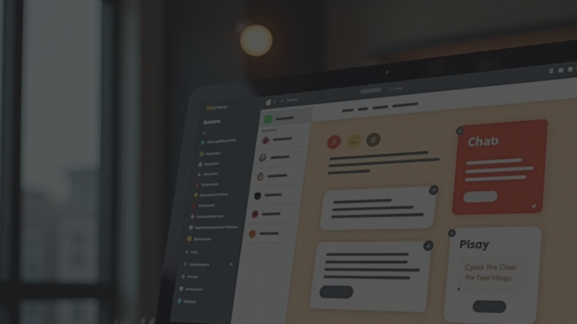


System Design & Architecture
Frontend:
Backend (suggested for real deployment):
• Modern HTML5, CSS3 (with custom properties/themes), JavaScript ES6+.
• RESTful APIs (Node.js, Django, or Spring Boot).
• Database (MySQL, MongoDB, or SQLite).
• Single-page application (SPA) structure.
• Authentication/authorization (JWT, sessions).
• Components: navbar, chat, modals, notifications.
• Secure storage of orders, users, restaurants, payments.
ER Diagram (Summary):
User ←→ Order ←→ Restaurant ←→ MenuItem.
Admin, DeliveryPartner, Wishlist, Review, Notification, LoyaltyPoints tables/entities in DB.

Slide 13

06
User Flow & Use Cases

Slide 14



User Flow & Use Cases
User Registration/Login → Browse/Search Restaurants → Filter/Select Menu → Add to Cart → Checkout & Payment → Order Tracking → Rate/Review.
Restaurant: Manage menu → Receive/fulfill orders → Update status.
Delivery: Accept assignment → Navigate/deliver → Update status.
Admin: Review analytics, manage accounts/menus/orders.

Slide 15

07
Advanced Features and Innovations

Slide 16
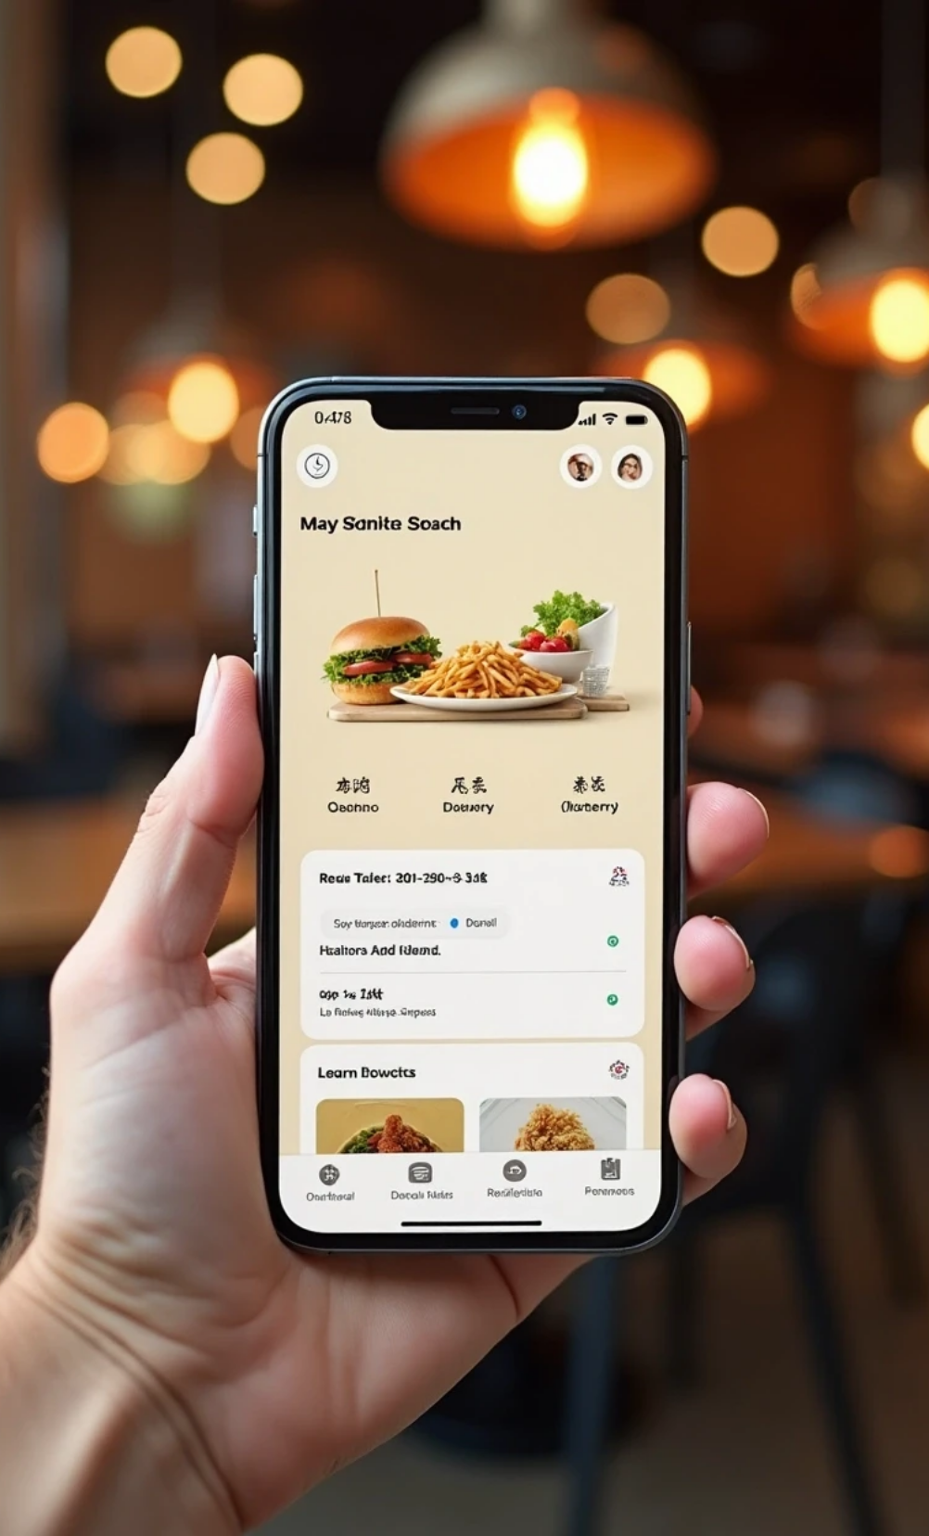

Advanced Features and Innovations
Swiggy-like
• Real-time order & delivery tracking.
• Loyalty reward system.
• Dietary/veg/non-veg filters.
• Push notifications & browser alerts.
• Voice search using Web Speech API.
• Multilingual UI (runtime switch).
• Interactive chat support.
• Dynamic promotions and coupons.
• Accessibility features for wider inclusion.

Slide 17
08
Testing, Security & Deployment

Slide 18


Testing, Security & Deployment
Testing
Security
Deployment
• Unit/integration testing (e.g., Jest, Mocha).
• Input validation.
• Can be hosted statically on platforms like Netlify/Vercel (SPA).
• HTTPS, secure local storage.
• User acceptance testing.
• Full-stack deployment with a backend server for production.
• Authentication safeguard for user/admin.
• UI/UX and cross-device compatibility checks.

Slide 19
09
Conclusion

Slide 20
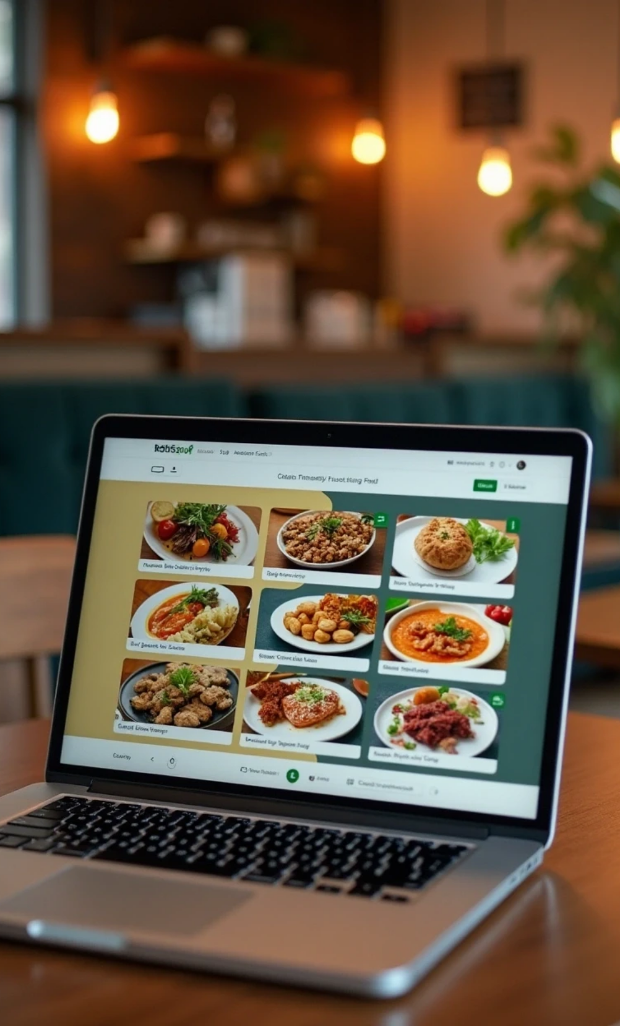
Conclusion
Foodie Express is a robust, fully-featured food ordering platform that supports both customers and administrators with powerful, intuitive, and modern web capabilities. Its scalable architecture, professional-grade user experience, and broad utility ensure it addresses the standards of today’s food delivery ecosystem.

Slide 21
10
Appendix

Slide 22
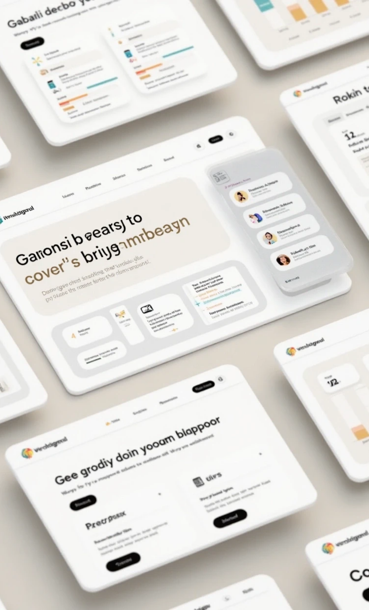
Appendix
Sample screenshots and UI layouts.
Additional diagrams (Use Case, DFD, ERD as needed).
Contact, support, and license info.

Slide 23
11
References:

Slide 24


References:
[Online food delivery system documentation].
[Swiggy/UberEats project samples].
[Design system and web best practices].
[Modern web application guidelines].

Slide 25
Thank You

